Slide 1
GROUP UNIQUE ID : AY20SECSM30106 MINI PROJECT
GROUP MEMBERS :
24_KINI_ADITYA
05_CHOUDHARY_NARENDRA
43_SAHANI_RATNESH
39_POOJARY_SHIPRA
GUIDE : MS.K.JAYAMALINI

Slide 2
VOICE ASSISTANT FOR VISUALLY IMPAIRED

Slide 3
PROBLEM STATEMENT
1
“ To develop a voice assistant using python/Java to help Visually Impaired people to easily access the technology and to guide them to their output ”

Slide 4



SOFTWARE REQUIREMENTS :
PYTHON/JAVA
VISUAL STUDIO 2010
(OR LATEST )
KITE

Slide 5
OBJECTIVE : To develop your skills in programming To develop the implementation of voice application in mobile. To study various features of voice emails. To identity the characteristics of system to convert voice to text. To develop a software to avoid any physical contact To develop an environment to help the needful. To study various mobile features To develop various software modules for doing various tasks with voice To understand how voice to text works

Slide 6
Summary
On the previous presentation we informed about how we are going to develop our mini project . Steps of developing the project ,literature review and many more .Now in this presentation we are going to discuss about the architecture and some functions of the project

Slide 7
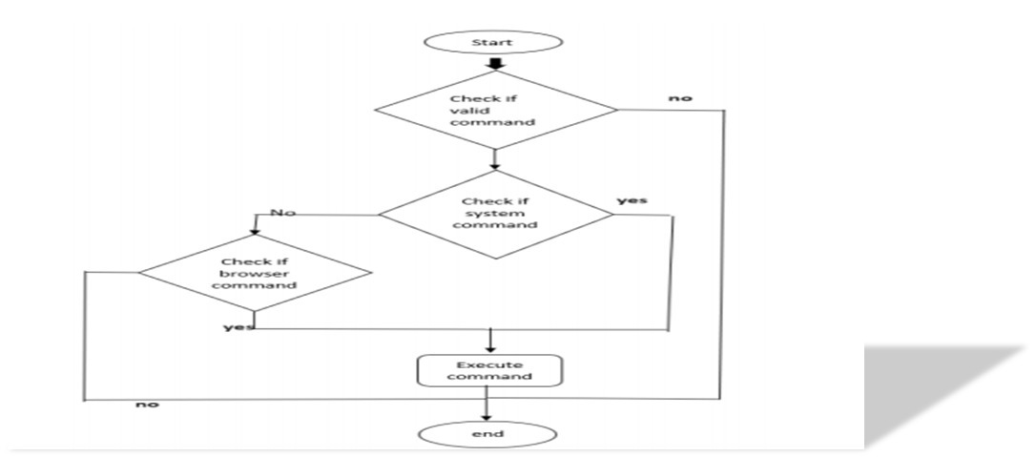
FLOWCHART :

Slide 8
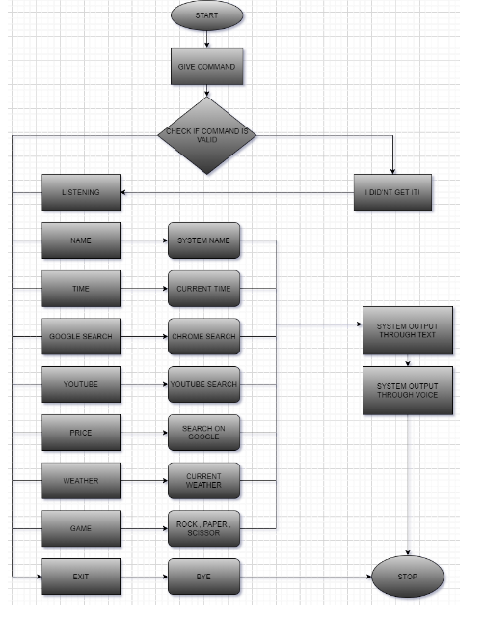
Flowchart :

Slide 9
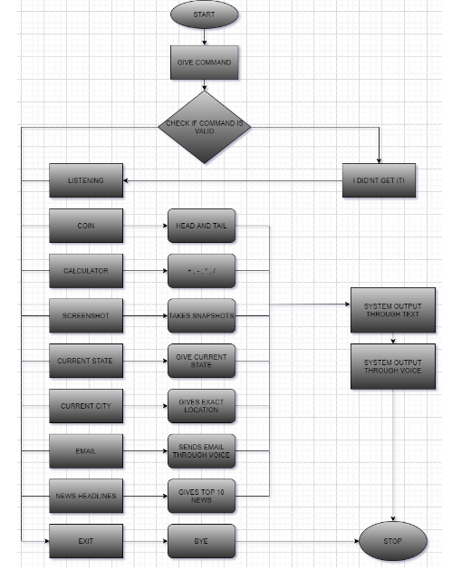
Flowchart:

Slide 10
PIP REQUIREMENTS :
Pip install speechrecognition
Pip install pyaudio
Pip install playsound
Pip install Py0bjC
Pip install gTTs
Pip install pyttsx3
Pip install wolframalpha
Pip install pylint
Pip install twilio
Pip install smtplib
Pip install json

Slide 11
Future Implementation
As voice assistance is not necessarily only for the blind people but also for children and for easy living .We might also add some more essential features
like ,
To direct the map on chrome.
Play Music through voice command.
To develop an app for easy access.
Ordering online .
Calling.
Messaging on whatsapp .

Slide 12
CONCLUSION :
The proposed system is used to help the visually impaired to have access to the most important features of the phone.
With advances in it and in technologies related to it Voice assistants can carryout even more complex tasks like booking tickets, etc.
This can be later improved by making the system to work, or understand the er’s voice even in more disturbing environment

Slide 13
REFERENCE :
https://www.slideshare.net/TanveerCSE/android-assistant-eye-mate-for-blind-and-blindtracker
https://www.ijrte.org/wp-content/uploads/papers/v9i2/A2753059120.pdf
https://www.emerald.com/insight/content/doi/10.1108/LHTN-11-2017-0083/full/html
https://theappsolutions.com/blog/how-to/develop-voice-assistant/
https://www.cuinsight.com/how-voice-assistants-can-benefit-people-with-disabilities.html#:~:text=The%20visually%20impaired%20who%20choose,to%20interact%20with%20the%20world

Slide 14
Implementation
https://drive.google.com/file/d/1yLM9Cc6WUhl6S2twAYSLeNpE6qVlfp4J/view?usp=sharing
https://drive.google.com/file/d/1jaCOdBbiejQ0DktlbU3CHfvVQWVU0tP4/view?usp=sharing

Slide 15
Thank You!!!

